Slide 1
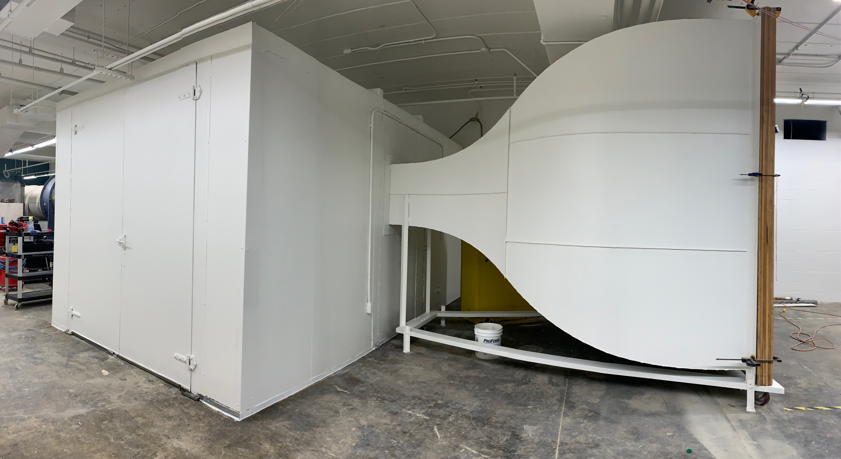
University of Dayton Wind Tunnel
Plenum
Fan
Contraction
Director: Dr. Sidaard Gunasekaran, Associate Professor, Mechanical and Aerospace Department
gunasekarans1@udayton.edu

Slide 2
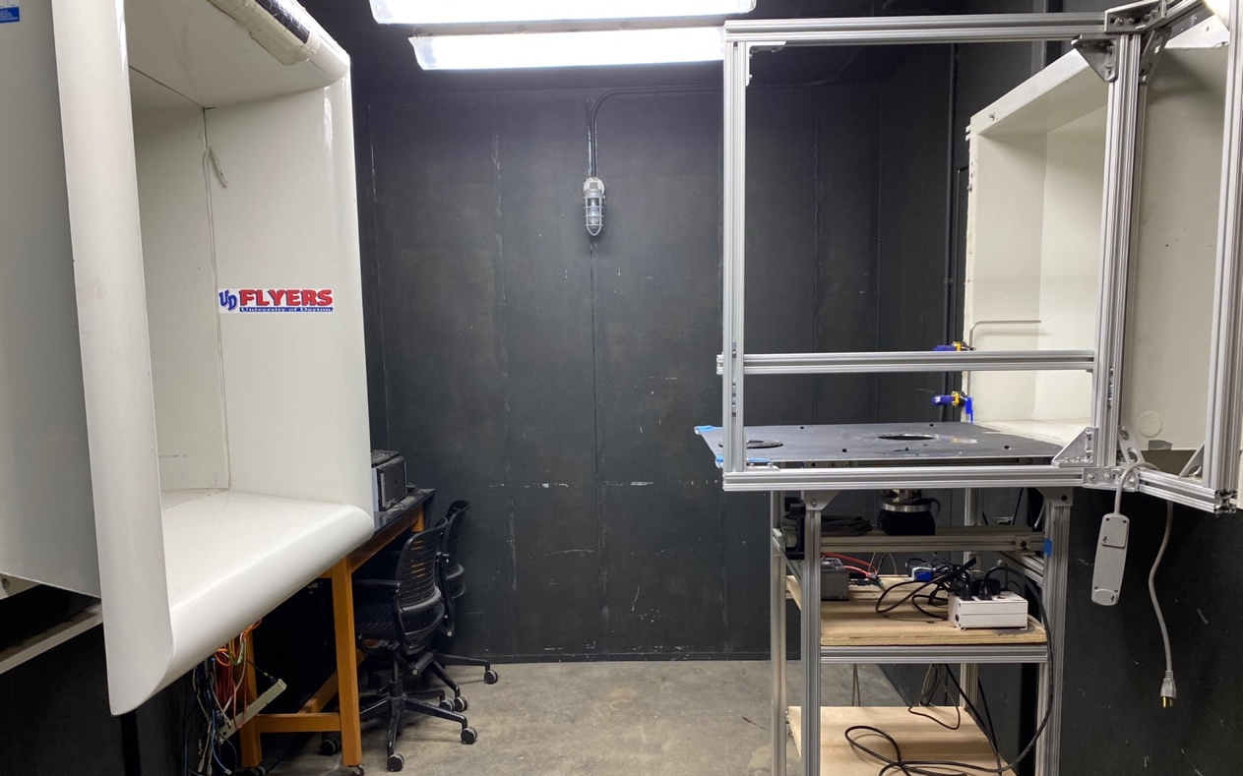
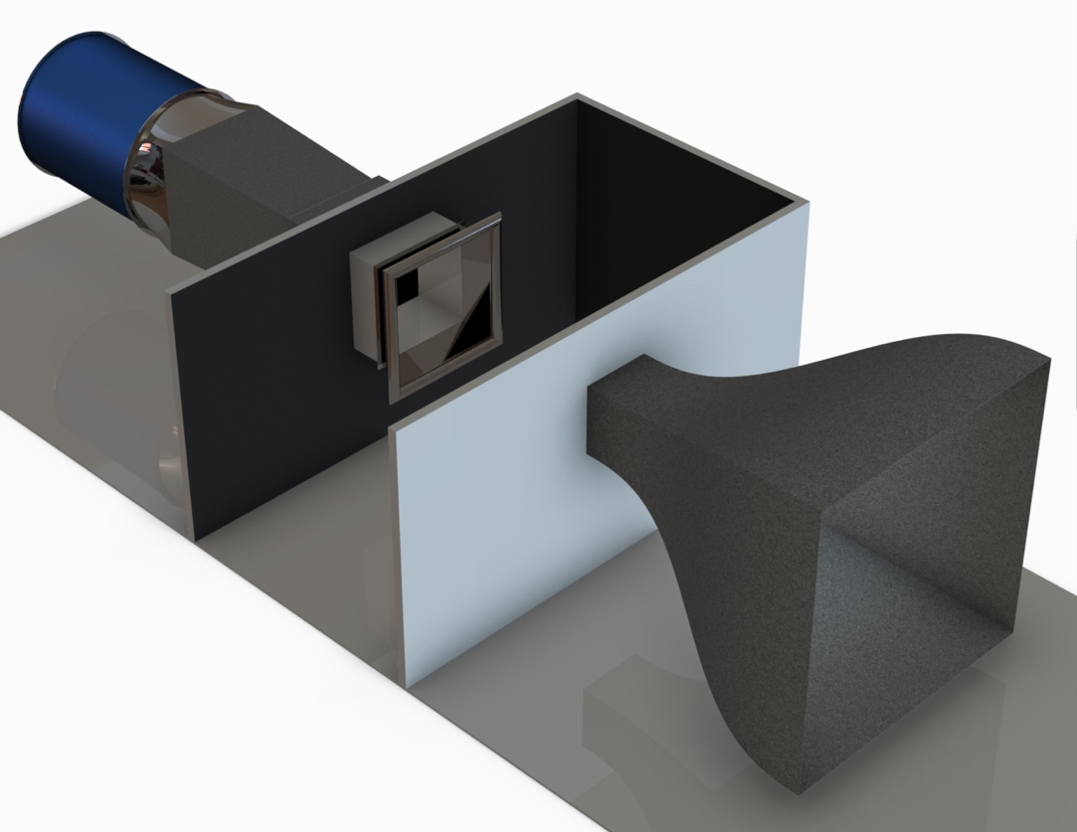
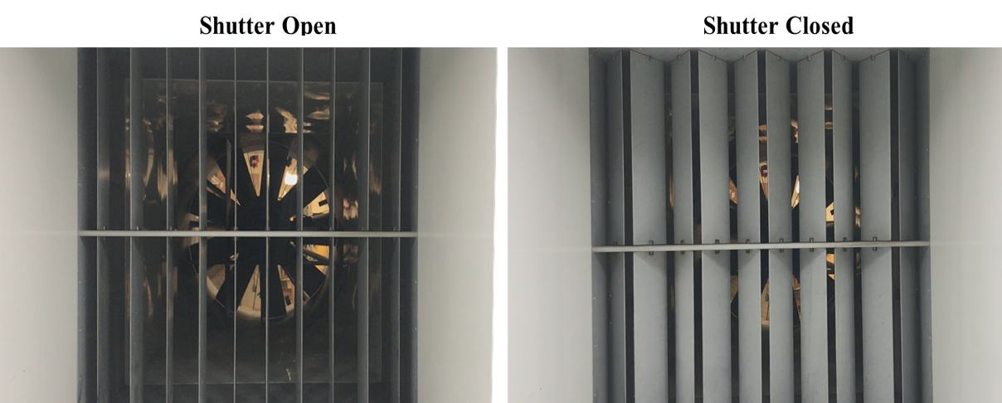
Specifications
Test Section Inlet
Eiffel Type w/16:1 Contraction Ratio
30” X 30” X 90” closed jet Test Section (~0.75 X 0.75 X 2.3 m)/Open jet
6 Anti-Turbulence Screens
60 HP (45 KW) Fan by Hartzell
Measured Turbulence Intensity < 0.1% (by Hot-Wire) in open jet
Speeds from 6.7 m/s (20 ft/s) to 36.7 m/s (120 ft/s)
Reynolds number range: 100,000 to 500,000 (Bluff and streamlined bodies)
4 Interchangeable closed jet Test Sections
Shuttering System (Gust generator)
Direction of Freestream
Collector
Fan
Diffuser
Plenum
Open Jet Test Section
Shuttering System
Contraction
Shutter Open
Shutter Closed
Collector

Slide 3
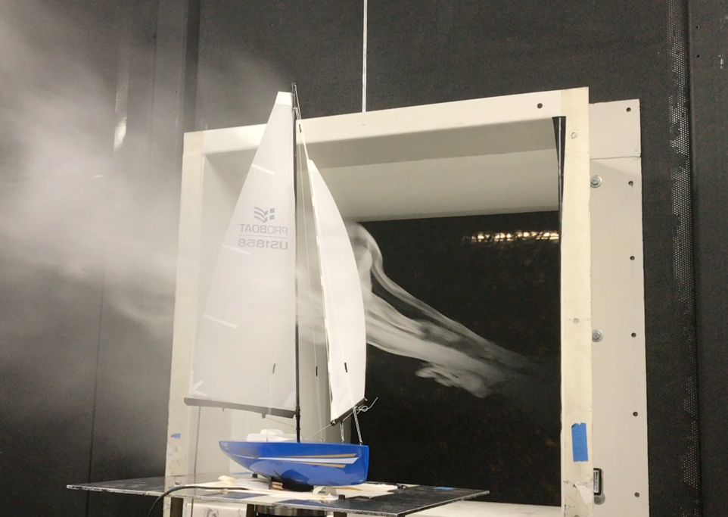
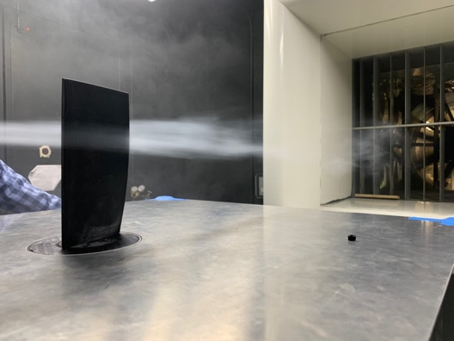
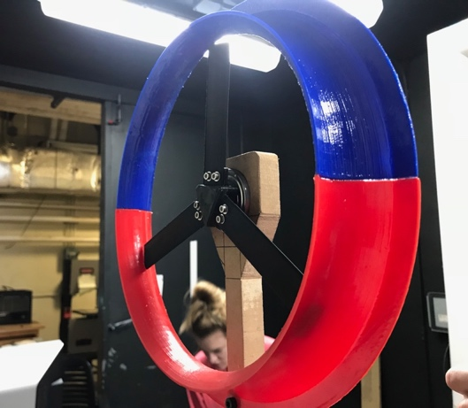
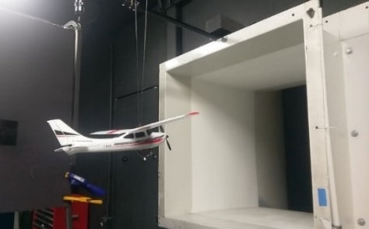
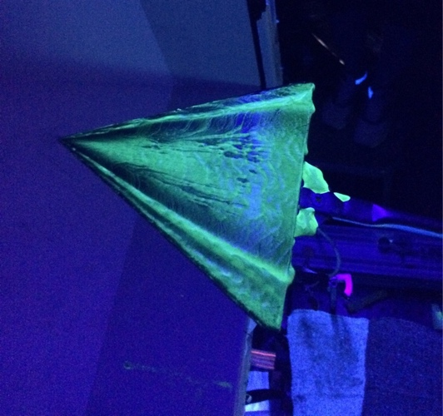
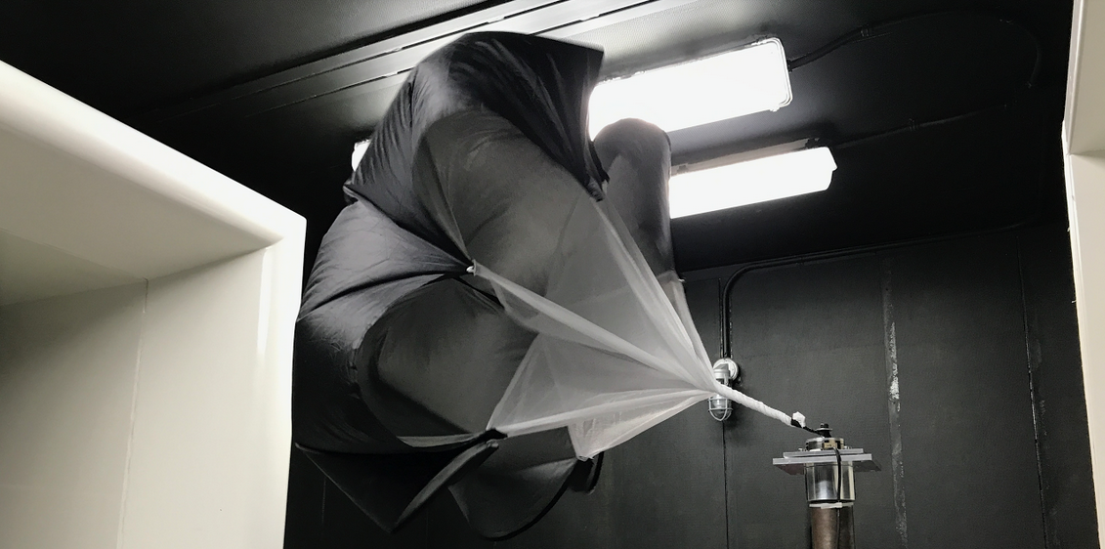
Capabilities
Smoke flow visualization in streamwise and cross-stream directions.
Surface flow visualizations using oil/clay/etc.
Particle Image Velocimetry (PIV) in streamwise and cross-stream directions.
Force based testing to obtain aerodynamic coefficients as a function of angle of attack.
Hot-wire anemometry .
On-body and off-body unsteady pressure measurements.
Streamwise gust profile generation with sinusoidal/custom acceleration profiles with max frequency of upto 5 Hz.
Spitfire aircraft model
Wingtip vortex

Slide 4
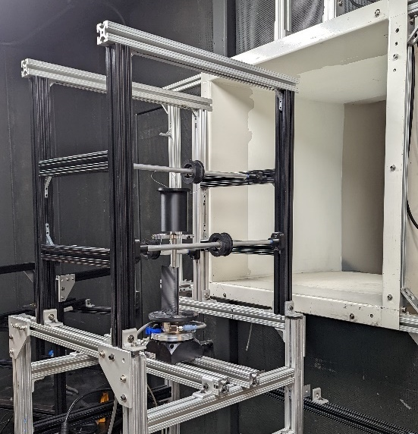
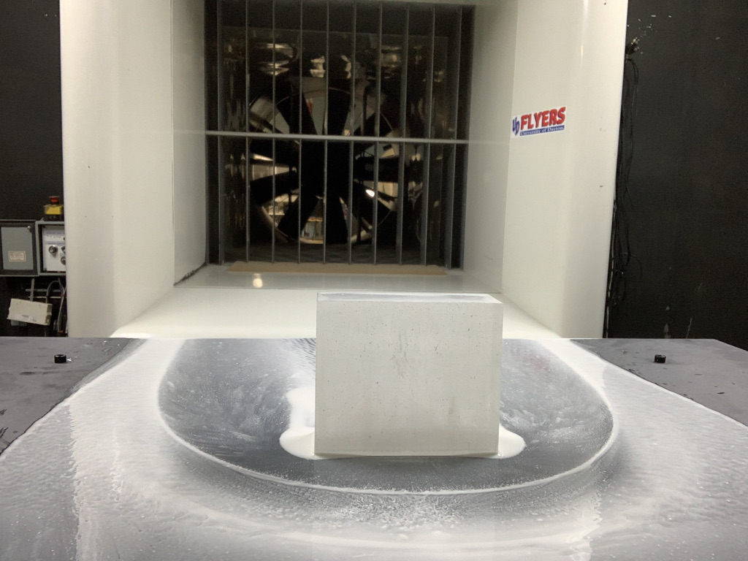
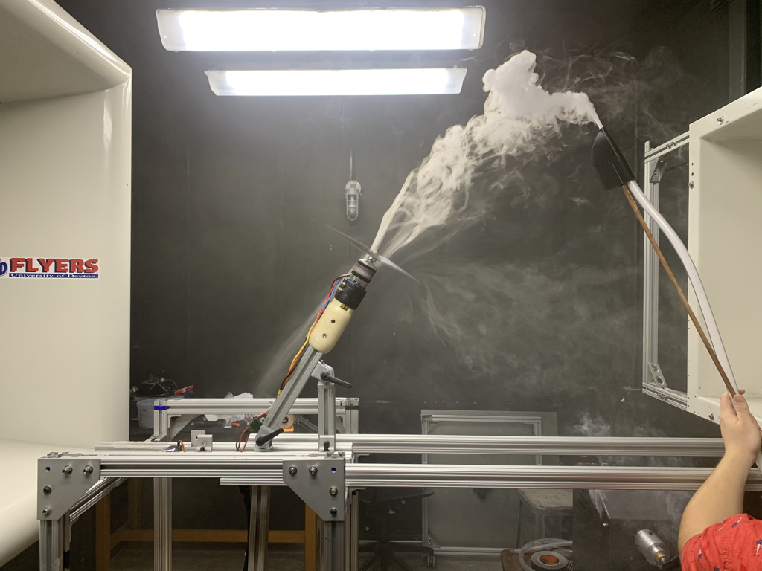
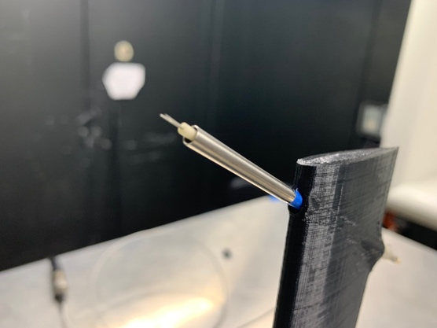
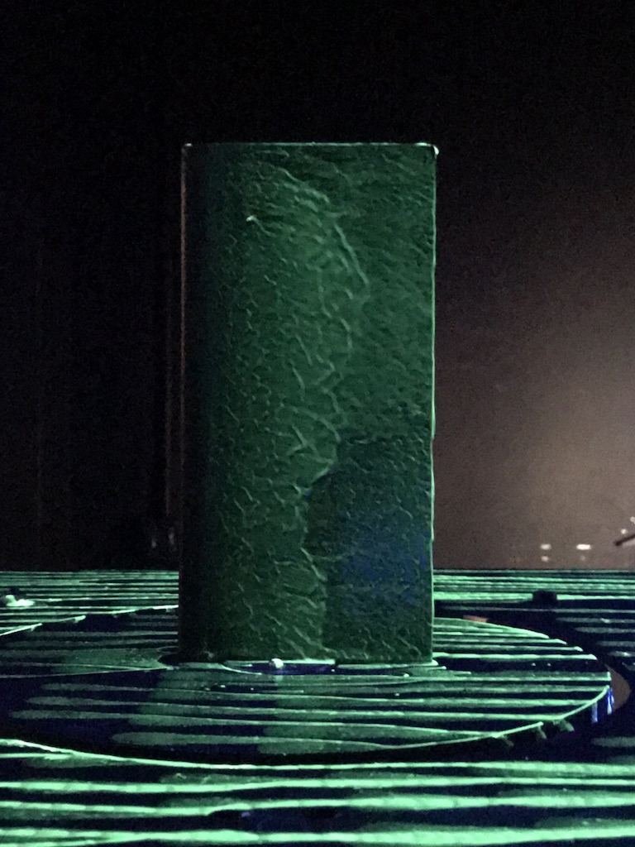
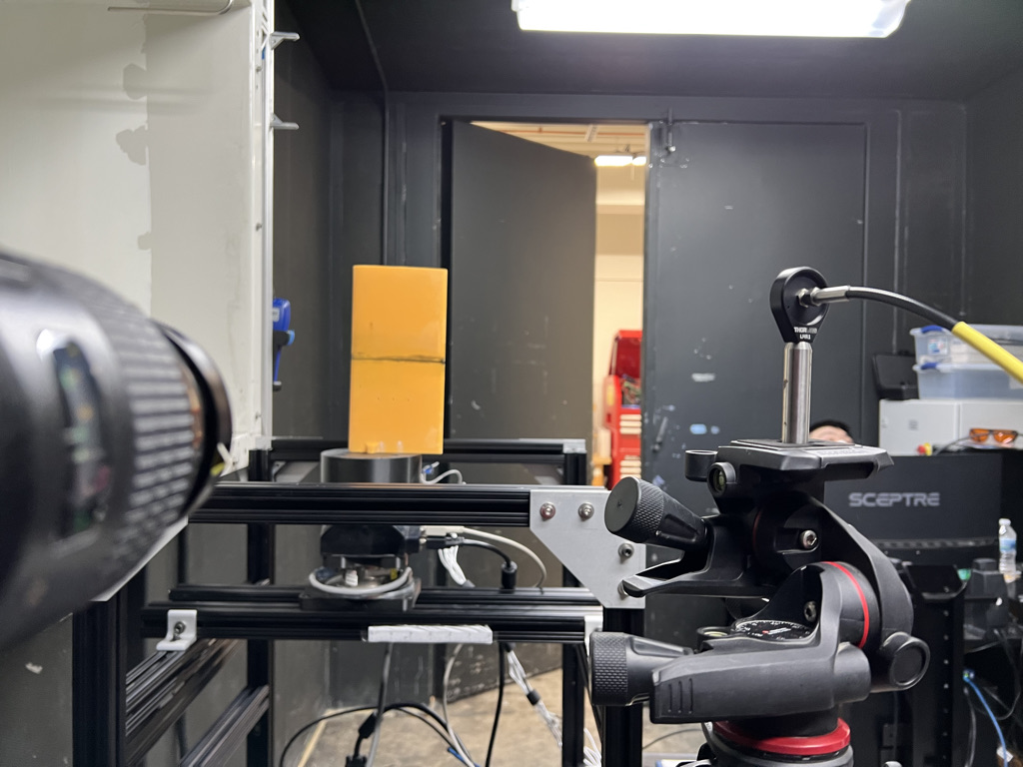
Quantitative and Qualitative Measurements
Sensors:
ATI Mini-40
Digital ATI Gamma
Analog ATI Gamma
ATI Nano 25
Aerolab Sting Mount
Single channel Dantec Hot-wire anemometer
Several unsteady pressure transducers (Kulites)
Flow Visualization:
Tuft flow viz
Smoke flow viz
TiO2 surface flow viz
Fluorescent dye flow viz

Slide 5
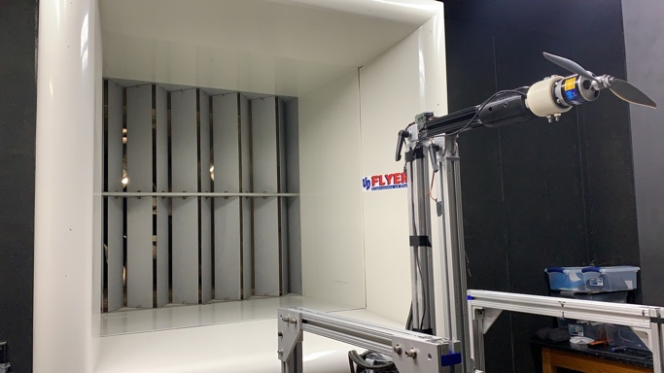
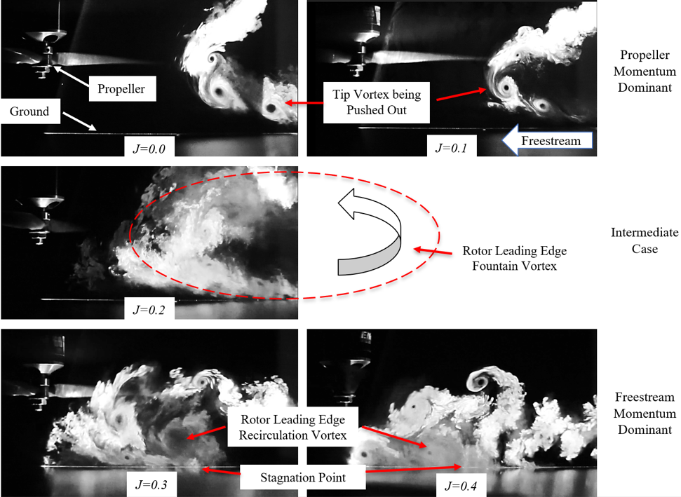
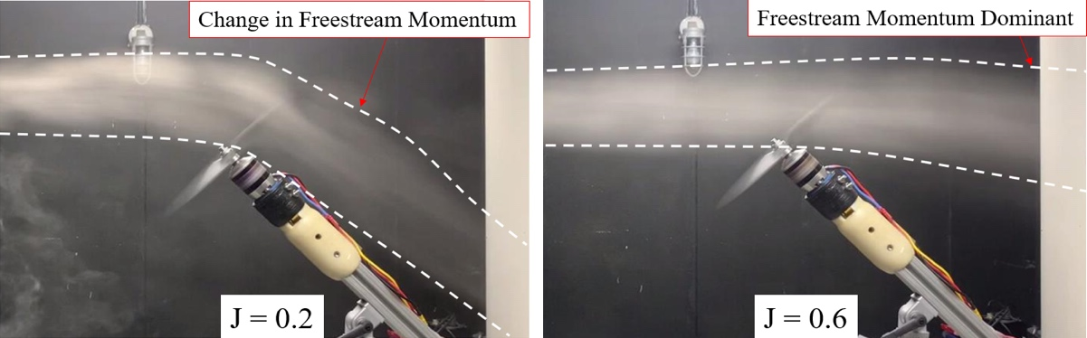
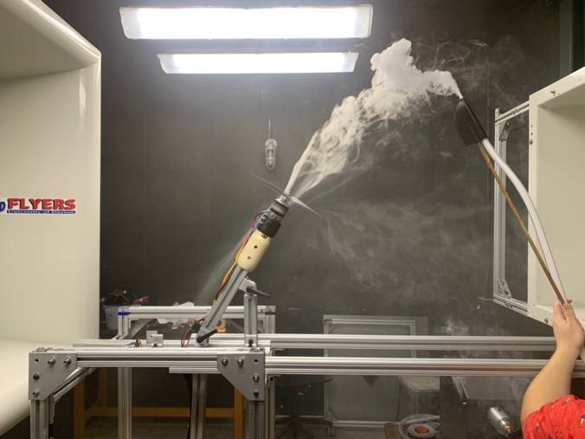
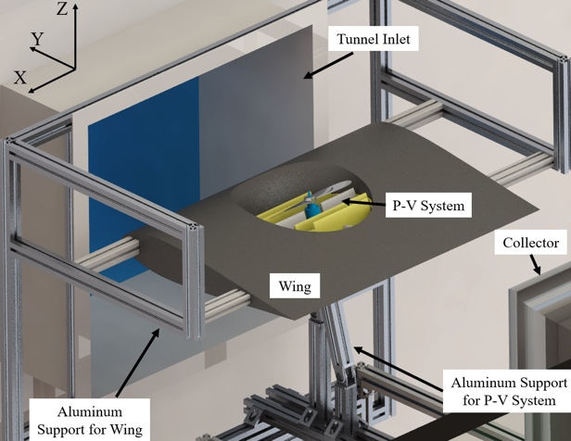
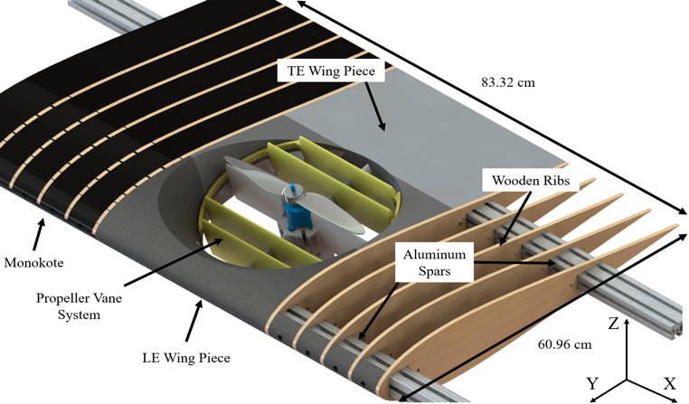
Propeller Testing Capabilities

Slide 6
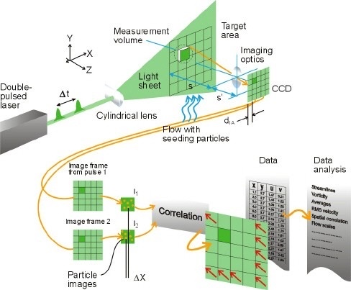
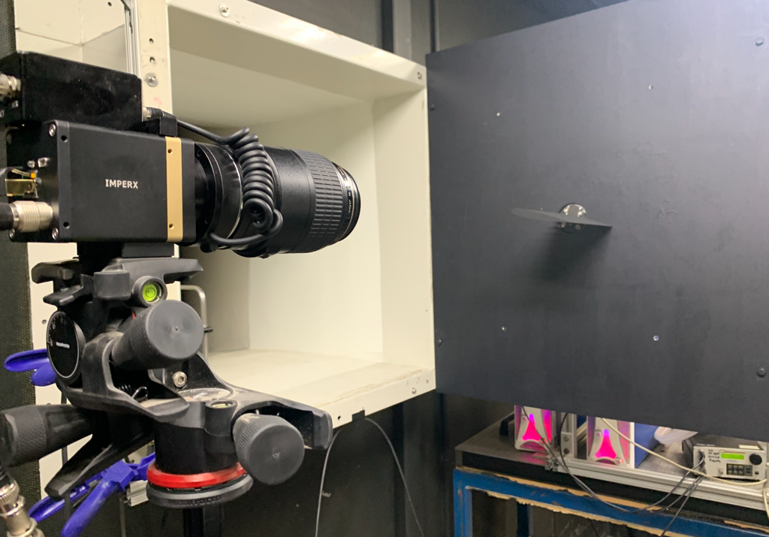
Particle Image Velocimetry (PIV) Capability
Seeding: Vicount smoke seeder with glycerin-based oil (mean diameter of 0.2 microns).
Light Source: Nd: YAG frequency doubled laser (Quantel Twins CFR 300)
Camera: The Imperx 4 MP B2021 camera with lens control.
Timing Box: Quantum Composer
Data Post Processing: DPIV Software

Slide 7

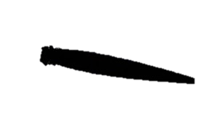
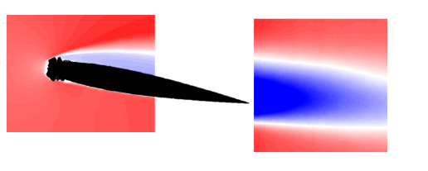
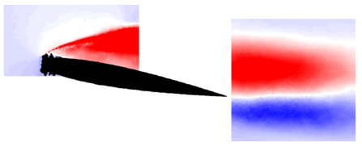
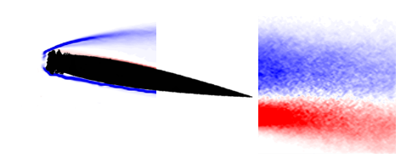
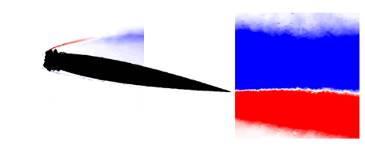
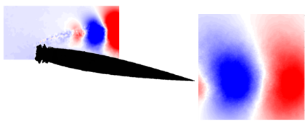





Example PIV Results
FOV 1
Eric Insana, “Low Reynolds number experimental aerodynamic verification of the scaled and LEWICE simulated ice accretions in SLD conditions”, Master’s Thesis, 2020, University of Dayton
FOV 3
$$\overline{U}/U_{∞}$$
FOV 2
FOV – Field of View
$$POD Mode 2 of U velocity$$
$$\left(ω_{z}c/U_{∞}\right)$$
$$u^{′}v^{′}/U_{∞}^{2}$$
$$POD Mode 2 of V velocity$$

Slide 8
